Slide 1
Statistical Process Control (SPC)
Nicholas Howe

Slide 2
Agenda
What is SPC?
Introduction to SPC Charts
Examples
Diagnostics

Slide 3
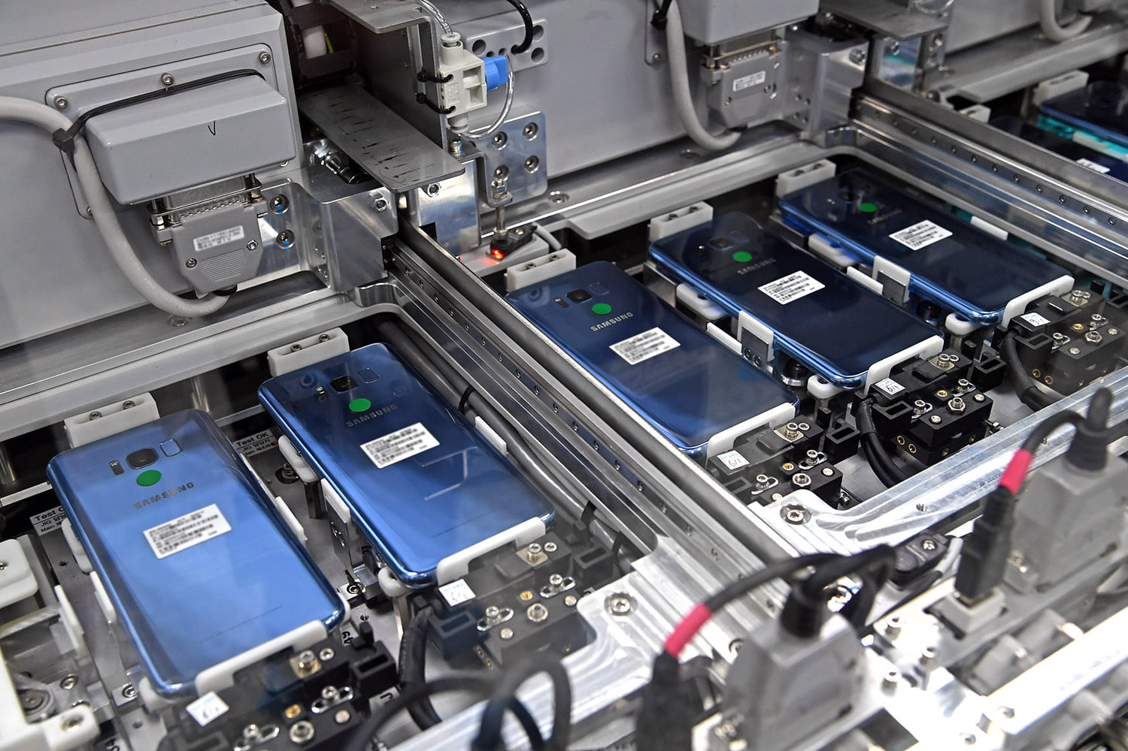
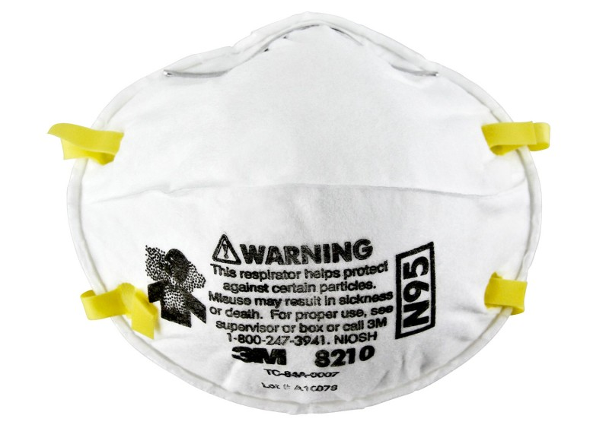
What is SPC?
To detect out of control process:
Significant change in mean
Significant change in variance
Examples:
Smartphone battery life
Particulate filtration efficiency
Quality control
Six Sigma standards
https://www.digitaltrends.com/mobile/behind-scenes-samsung-designed-built-galaxy-s8-s8/
https://www.3m.com.sg/3M/en_SG/company-sg/all-3m-products/~/3M-Particulate-Respirator-8210-N95-160-Case/?N=5002385+3294780268&rt=rud
http://multimedia.3m.com/mws/media/312703O/masks-and-respirators-tri-fold-brochure-eng.pdf

Slide 4
Introduction to SPC Charts

Slide 5
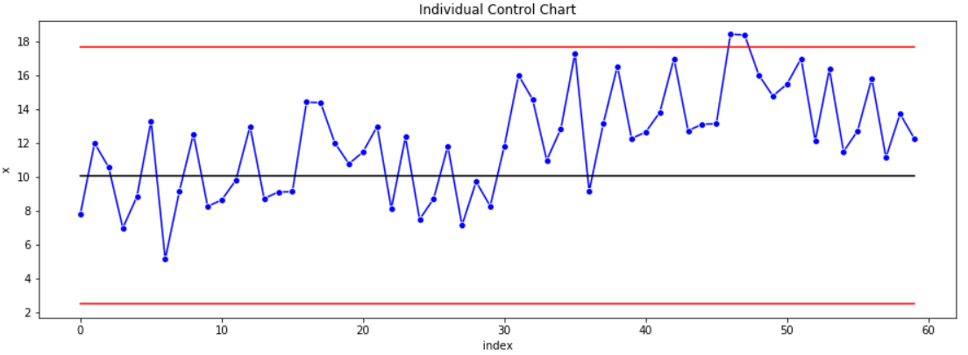
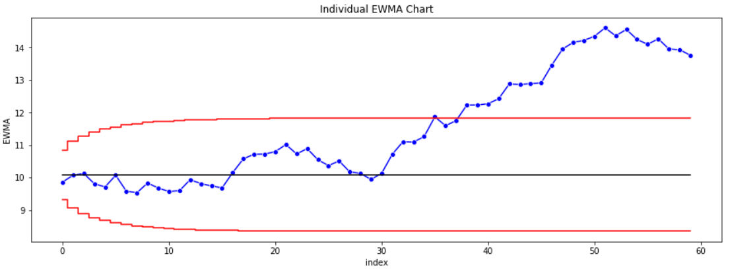
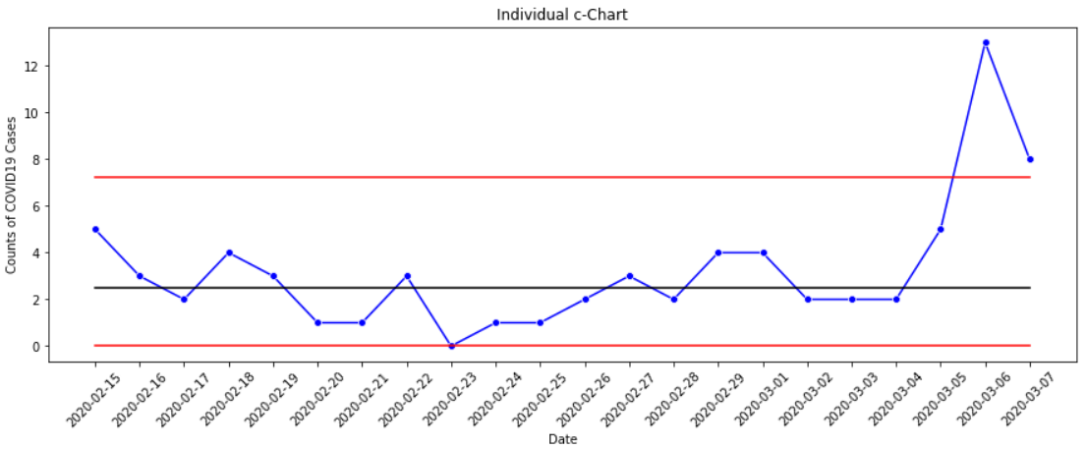
Types of SPC Charts
Variable
Continuous data
Time Weighted
Increased sensitivity to out of control process
Attribute
Counts data
Assumptions
Independence
Normally distributed

Slide 6
Summary of SPC charts
Variable
$\overline{x},s$
𝑥 ̅,𝑠
$\overline{x},R$
𝑥 ̅,𝑅
Time Weighted
EWMA
$x, R$
𝑥, 𝑅
Tabular Cusum
$s^{2}$
𝑠^2
$R$
𝑅
$s$
𝑠
Attribute
p-chart
np-chart
c-chart
u-chart

Slide 7
SPC Chart Components
1. Upper Control Limit (UCL)
4. Observations
2. Center
General Formula (L-sigma control limit)
$$UCL=μ_{0}+L\hat{σ}$$
UCL=𝜇_0+𝐿𝜎 ̂
$$LCL=μ_{0}−L\hat{σ}$$
LCL=𝜇_0−𝐿𝜎 ̂
$$Center=μ_{0}$$
Center=𝜇_0
3. Lower Control Limit (LCL)

Slide 8
Setting Up SPC Charts
Process in control
Phase I
Get process under control or select a period where process is under control
Phase II
Use SPC chart to monitor process
Estimate required parameters from in control data
Construct SPC chart
Determine assignable cause when process signals out of control
General Formula (L-sigma control limit)
$$UCL=μ_{0}+L\hat{σ}$$
UCL=𝜇_0+𝐿𝜎 ̂
$$LCL=μ_{0}−L\hat{σ}$$
LCL=𝜇_0−𝐿𝜎 ̂
$$Center=μ_{0}$$
Center=𝜇_0

Slide 9
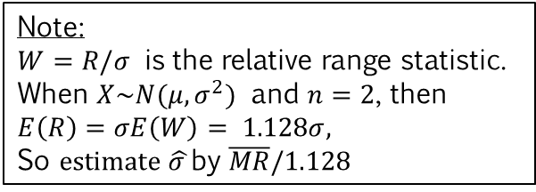
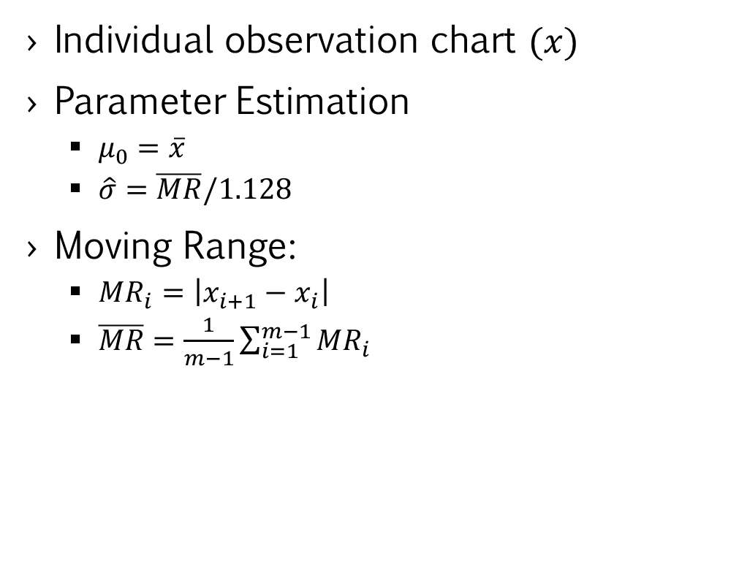

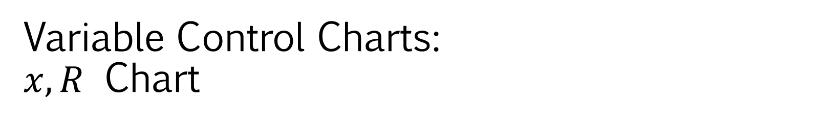



Variable Control Charts: $x, R$ Chart
Individual observation chart $(x)$
Parameter Estimation
$μ_{0}=\overline{x}$
$\hat{σ}=\overline{MR}/1.128$
Moving Range:
$MR_{i}=\left|x_{i+1}−x_{i}\right|$
$\overline{MR}=\frac{1}{m−1}\sum_{i=1}^{m−1}{MR_{i}}$
$${MR}_{2}$$
$${MR}_{4}$$
$${MR}_{1}$$
$${MR}_{3}$$
Chart Parameters (L-sigma control limit)
$$UCL=μ_{0}+L\hat{σ}=μ_{0}+L∗\overline{MR}/1.128$$
UCL=𝜇_0+𝐿𝜎 ̂=𝜇_0+𝐿∗(𝑀𝑅) ̅/1.128
$$LCL=μ_{0}−L\hat{σ}=μ_{0}−L∗\overline{MR}/1.128$$
LCL=𝜇_0−𝐿𝜎 ̂=𝜇_0−𝐿∗(𝑀𝑅) ̅/1.128
$$Center=μ_{0}$$
Center=𝜇_0
Note:
$W=R/σ$ is the relative range statistic.
When $X\sim N(μ,σ^{2})$ and $n=2$, then
$E\left(R\right)=σE\left(W\right)=$ $1.128σ,$
So $estimate \hat{σ }$by $\overline{MR}/1.128$

Slide 10


Time Weighted Control Charts – EWMA
Exponentially Weighted Moving Average (EWMA)
Better detection of small changes in mean
Parameter Estimation
$μ_{0}=\overline{x}$
$\hat{σ}=\overline{MR}/1.128$
EWMA Formula
$z_{0}=μ_{0}$
𝑧_0=𝜇_0
$$z_{i}=λx_{i}+\left(1−λ\right)z_{i−1}, 0<λ<1, i=1,2,…$$
𝑧_𝑖=𝜆𝑥_𝑖+(1−𝜆) 𝑧_(𝑖−1), 0<𝜆<1, 𝑖=1,2,…
Chart Parameters (L-sigma control limit)
$$UCL_{i}=μ_{0}+L∗σ\sqrt{\frac{λ}{2−λ}[1−{\left(1−λ\right)}^{2i}]}$$
UCL_i=𝜇_0+𝐿∗𝜎√(𝜆/(2−𝜆)[1−(1−𝜆)^2𝑖])
$$Center=μ_{0}$$
Center=𝜇_0
$$LCL_{i}=μ_{0}−L∗σ\sqrt{\frac{λ}{2−λ}[1−{\left(1−λ\right)}^{2i}]}$$
LCL_i=𝜇_0−𝐿∗𝜎√(𝜆/(2−𝜆)[1−(1−𝜆)^2𝑖])
Note: Typically choose $λ=0.1$

Slide 11
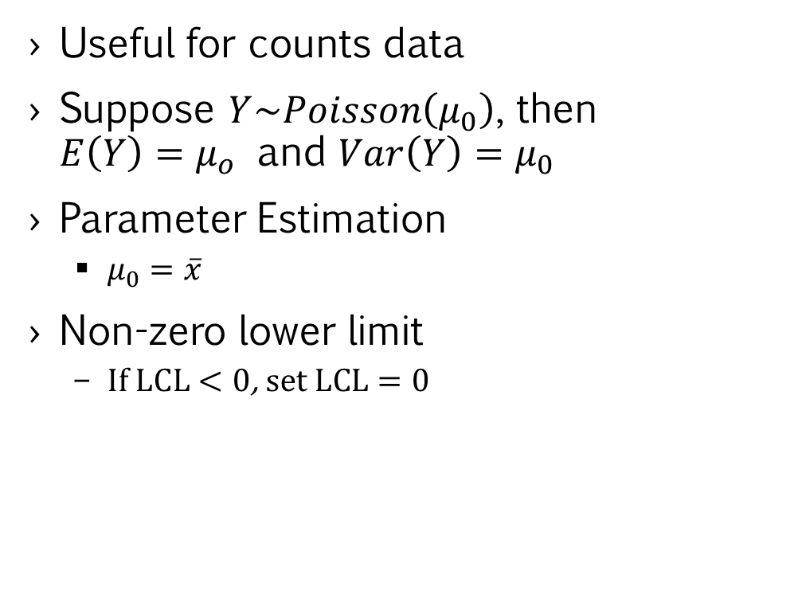
Attribute Control Charts – c-chart
Useful for counts data
Suppose $Y\sim Poisson\left(μ_{0}\right)$, then $E\left(Y\right)=μ_{o}$ and $Var\left(Y\right)=μ_{0}$
Parameter Estimation
$μ_{0}=\overline{x}$
Non-zero lower limit
If $LCL<0$, set $LCL=0$
Chart Parameters (L-sigma control limit)
$$UCL=μ_{0}+L\hat{σ}=μ_{0}+L∗\sqrt{μ_{0}}$$
UCL=𝜇_0+𝐿𝜎 ̂=𝜇_0+𝐿∗√(𝜇_0 )
$$LCL=μ_{0}−L\hat{σ}=μ_{0}−L∗\sqrt{μ_{0}}$$
LCL=𝜇_0−𝐿𝜎 ̂=𝜇_0−𝐿∗√(𝜇_0 )
$$Center=μ_{0}$$
Center=𝜇_0

Slide 12
Examples

Slide 13
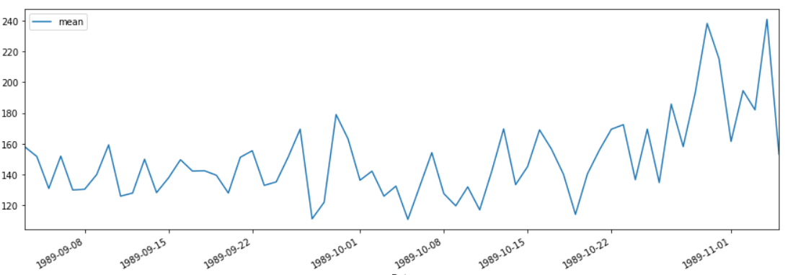
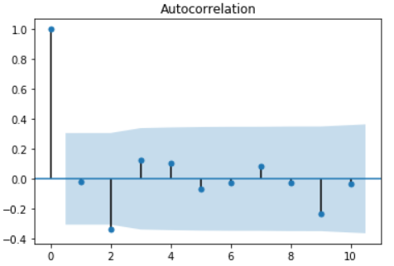
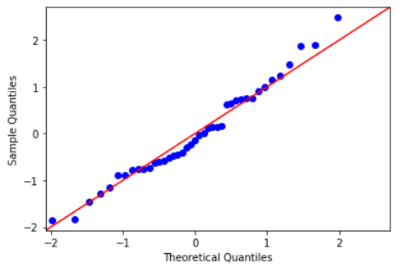
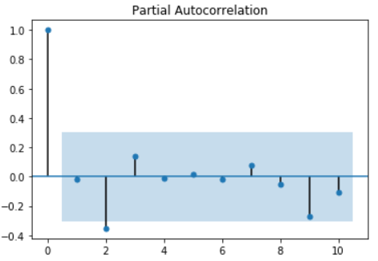
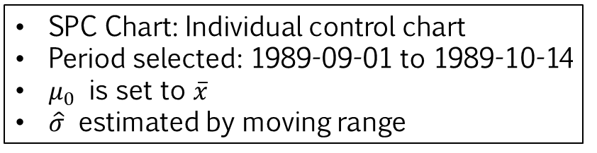
Individual Blood Glucose Tracking (1/2)
1. Select in-control data
Process in control
SPC Chart: Individual control chart
Period selected: 1989-09-01 to 1989-10-14
$μ_{0}$ is set to $\overline{x}$
$\hat{σ}$ estimated by moving range
2. Check Assumptions
Ljung–Box Test: No significant autocorrelation up to lag 10
Jarque-Bera Test: Distribution is not significantly different from Gaussian

Slide 14
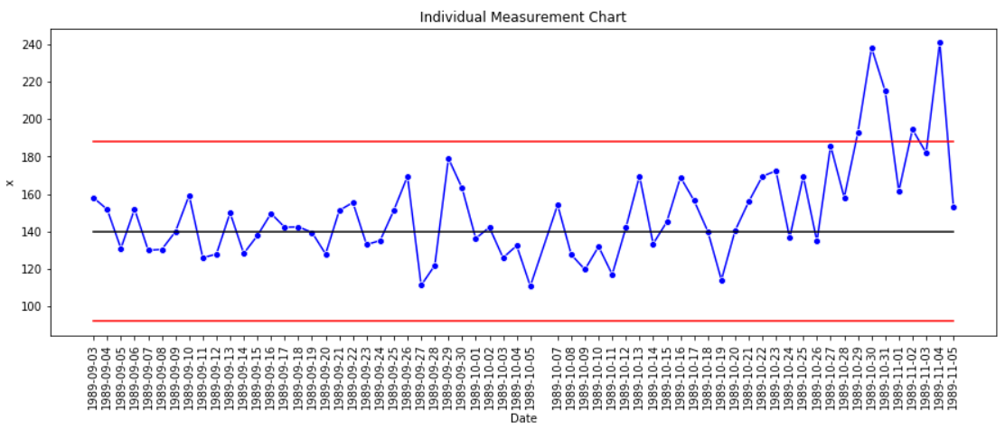
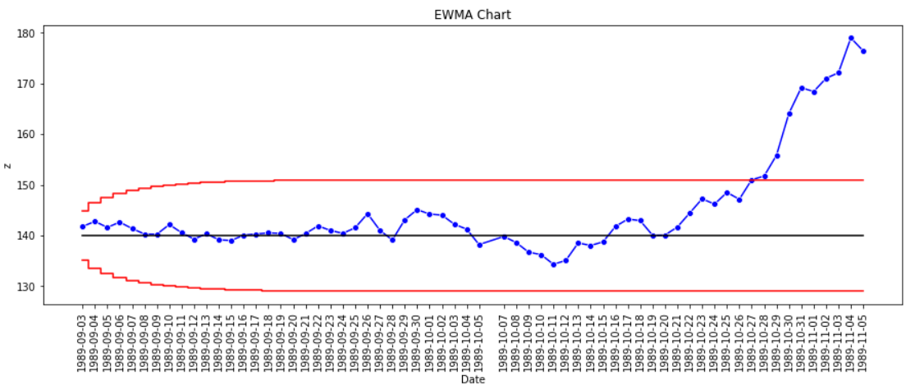
Individual Blood Glucose Tracking (2/2)
3. Construct Individual Control chart
Process first signals out of control on 1989-10-29
EWMA detects out of control mean 2 days earlier!
4. Construct EWMA Chart
Process first signals out of control on 1989-10-27

Slide 15
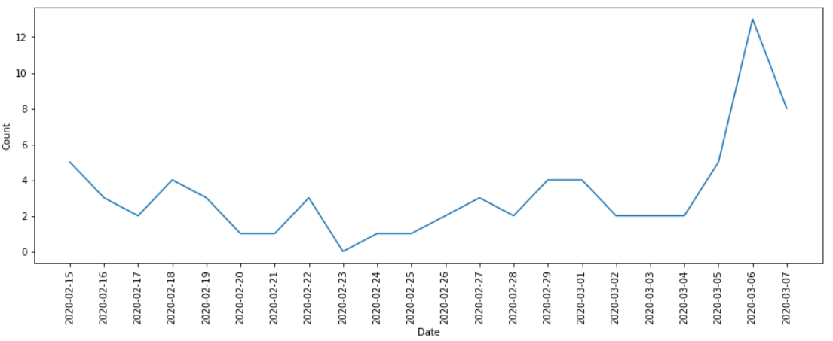
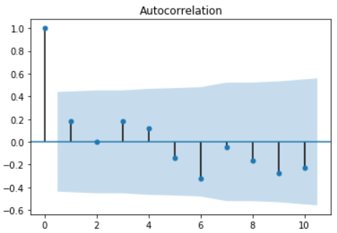
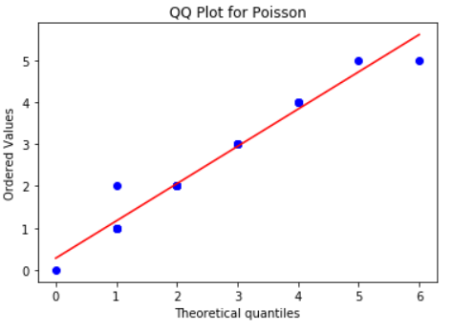
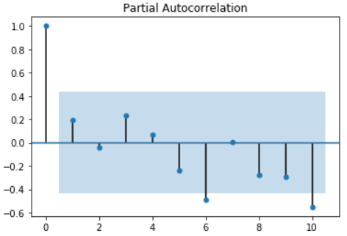
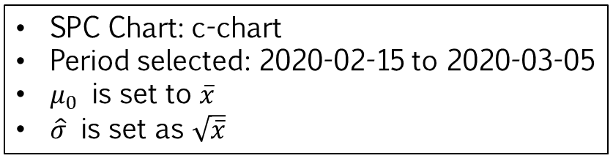
Singapore COVID-19 Cases (1/2)
1. Select in-control data
Process in control
SPC Chart: c-chart
Period selected: 2020-02-15 to 2020-03-05
$μ_{0}$ is set to $\overline{x}$
$\hat{σ}$ is set as $\sqrt{\overline{x}}$
2. Check Assumptions
Ljung–Box Test: No significant autocorrelation up to lag 10
Chi-sq Goodness of fit Test: Distribution is not significantly different from Poisson

Slide 16
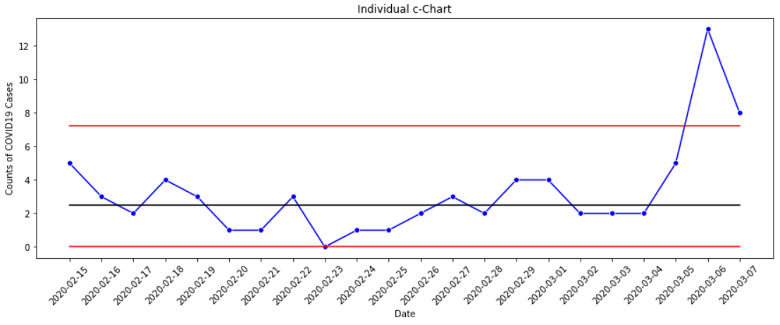
Singapore COVID-19 Cases (2/2)
3. Construct Individual Control chart
Process first signals out of control on 2020-03-06

Slide 17
Diagnostics

Slide 18
Violations of Assumptions
Violation of Normality
Skewed distributions
Heavy-tailed distributions
Violation of Independence
Autocorrelated process
Properties of Normal Distribution
Skewness = 0
Kurtosis = 3

Slide 19
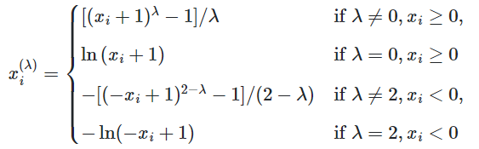
Skewed distributions (1/3)
Results in false positives
Can be transformed into approximately Gaussian using the Yeo-Johnson Transformation
The Yeo-Johnson transformation is defined as:
Build individual control chart based on transformed data
Reverse transform control limits and transformed data

Slide 20
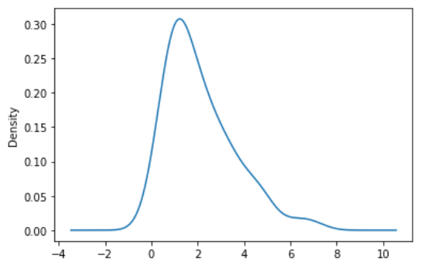
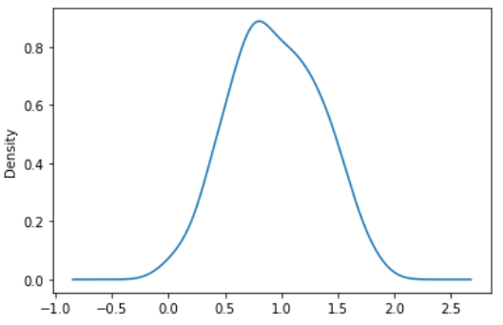
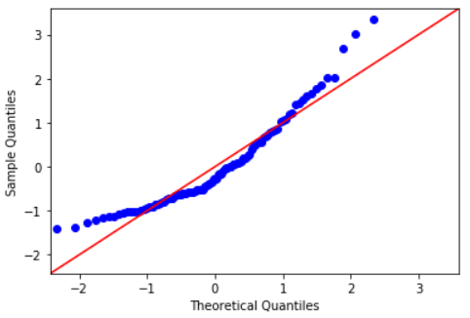
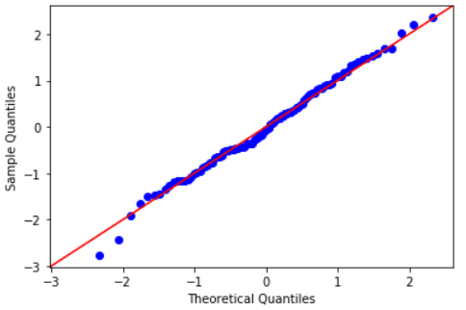
Skewed distributions (2/3) Gamma Distribution (Right Skewed)
KDE and QQnorm for Gamma Distribution
KDE and QQnorm for Transformed Distribution
Yeo-Johnson Transformation

Slide 21
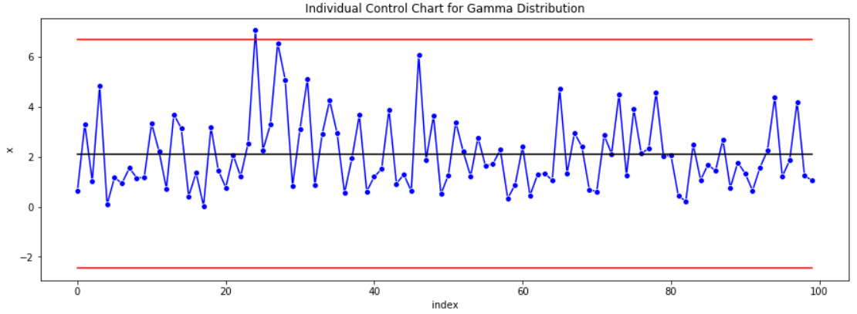
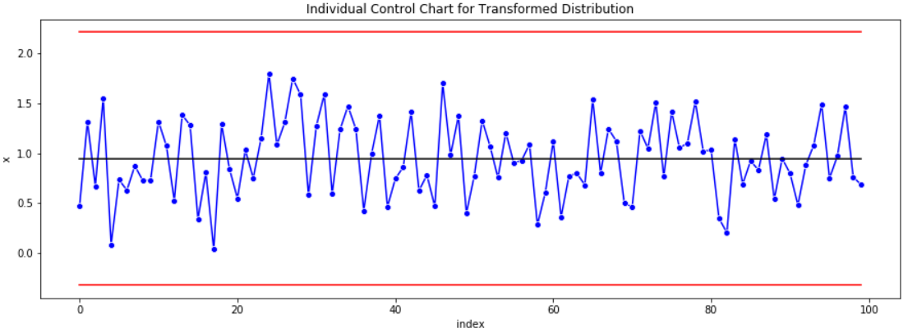
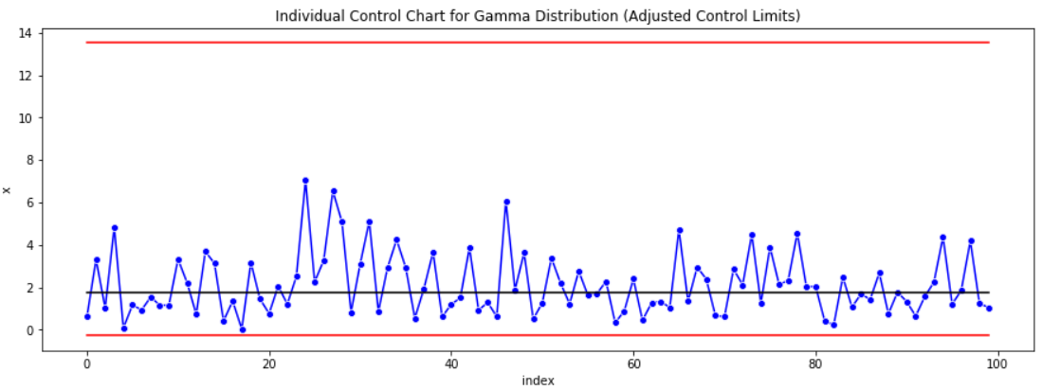
Skewed distributions (3/3) Gamma Distribution (Right Skewed)
Yeo-Johnson Transformation
Reverse Transform Control Limits and transformed data
General Formula (L-sigma control limit)
$$UCL=μ_{0}+L\hat{σ}$$
UCL=𝜇_0+𝐿𝜎 ̂
$$LCL=μ_{0}−L\hat{σ}$$
LCL=𝜇_0−𝐿𝜎 ̂
$$Center=μ_{0}$$
Center=𝜇_0

Slide 22
Skewed distributions (3/3) Gamma Distribution (Right Skewed)
Construct SPC chart based on original distribution
Yeo-Johnson Transformation
Construct SPC chart based on transformed distribution
Back transform Control Limits and transformed observations
Original observations with back transformed control limits

Slide 23
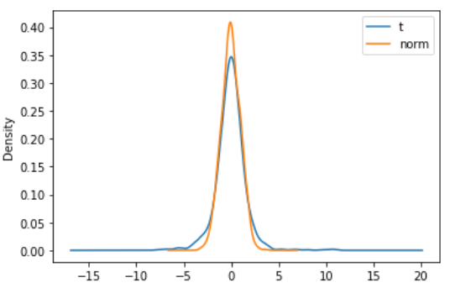
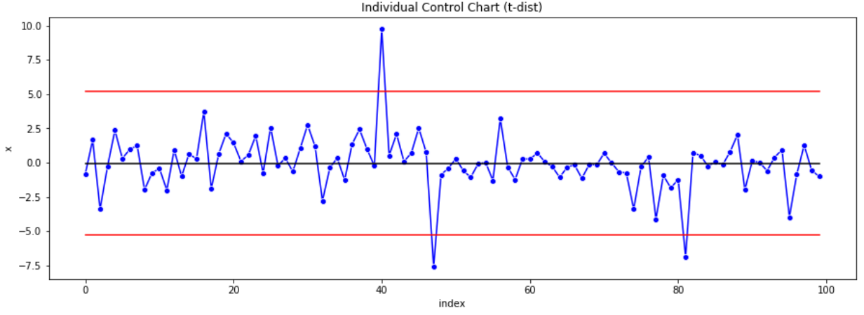
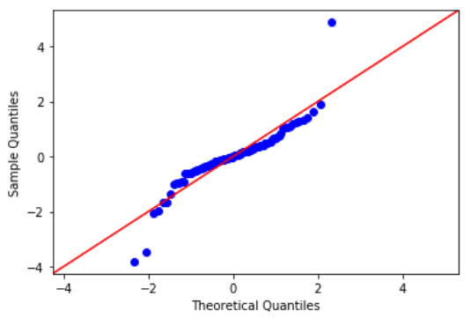
Heavy-tailed distributions (1/2) Student's t-distribution
KDE and QQnorm for
t Distribution
Individual Control Chart
Remedies
Live with additional false positives
Increase control limit

Slide 24
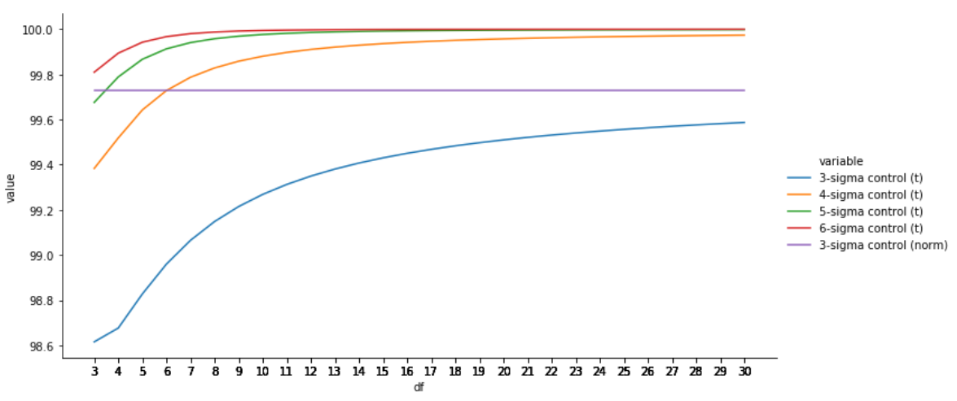

Heavy-tailed distributions (2/2) Student's t-distribution
L-sigma Coverage for t-dist and normal dist
$df=6$, use 4-sigma control limits

Slide 25
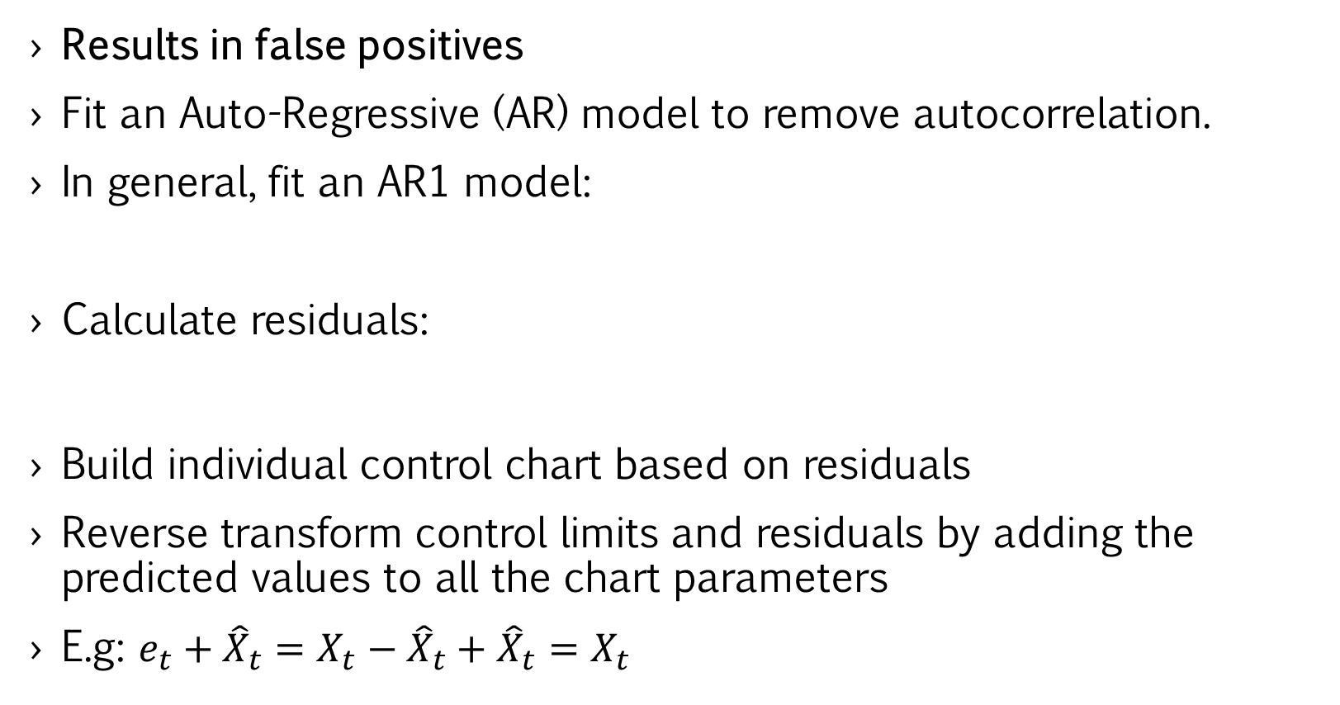
Autocorrelated Process (1/2) AR1 Simulation
Results in false positives
Fit an Auto-Regressive (AR) model to remove autocorrelation.
In general, fit an AR1 model:
Calculate residuals:
Build individual control chart based on residuals
Reverse transform control limits and residuals by adding the predicted values to all the chart parameters
E.g: $e_{t}+{\hat{X}}_{t}=X_{t}−{\hat{X}}_{t}+{\hat{X}}_{t}=X_{t}$

Slide 26
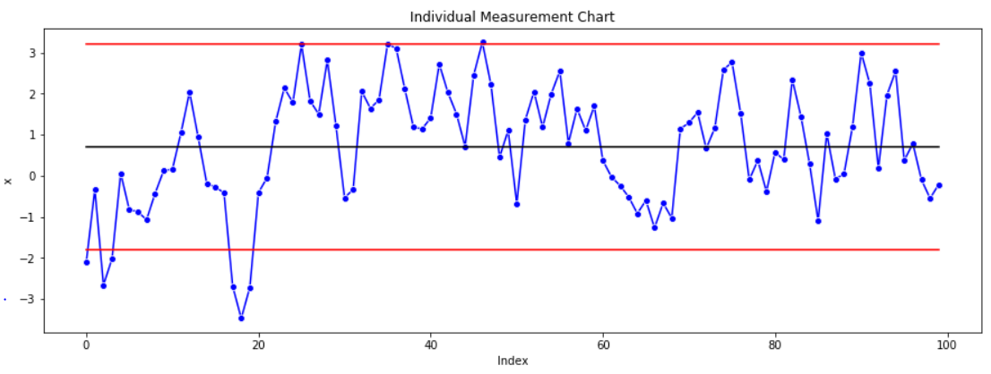
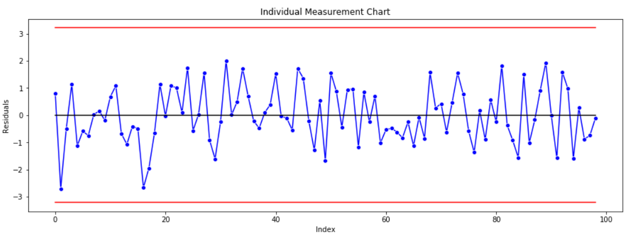
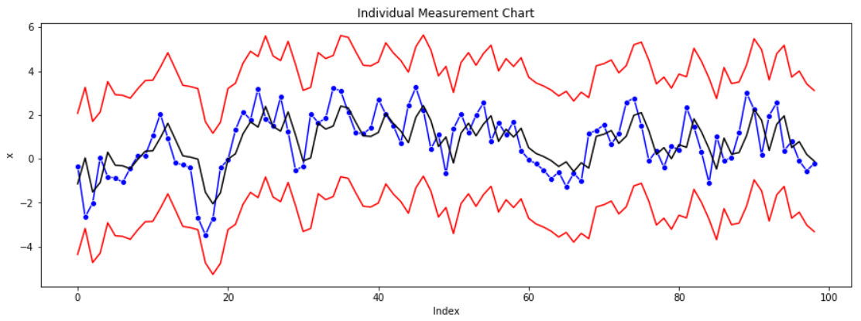
Autocorrelated Process (2/2) AR1 Simulation
Construct SPC chart based on original distribution
Fit AR1 model and calculate residuals
Construct SPC chart based on transformed distribution
Back transform Control Limits and residuals
Original observations with back transformed control limits

Slide 27
Thank You!

Slide 28
Appendix

